Slide 1
DM TA Session 6
Hanwen Serena Xu
hanwen@uchicago.edu

Slide 2
Contents
Homework 3
Cross-validation
Bootstrap

Slide 3
Cross-validation
Hold-out method
K-fold cross validation
Leave-one-out cross validation

Slide 4
Hold-out Method
DT are versatile Machine Learning algorithms that can perform both classification and regression tasks
Pros
Take little time to compute
Cons
High variance. The evaluation may depend heavily on which data points end up in the training set and which end up in the validation set.
Unless you are working with a very large data set.

Slide 5
Hold-out Method
It is common to use 80% of the data for training and hold out 20% for testing
If dataset contains 10 million instances, then holding out 1% means your test set will contain 100,000 instances, probably more than enough to get a good estimate of the generalization error

Slide 6
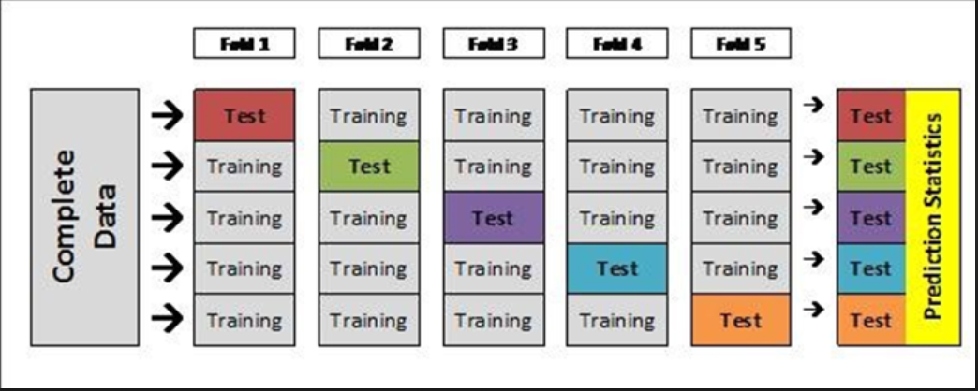
K-fold Cross Validation
Pros
It matters less how the data gets divided. Every data point gets to be in a test set exactly once and gets to be in a training set k-1 times. Another example is that you can independently choose how large each test set is and how many trials you average over.
Cons
Computational heavy
https://www.youtube.com/watch?v=g9c66TUylZ4

Slide 7
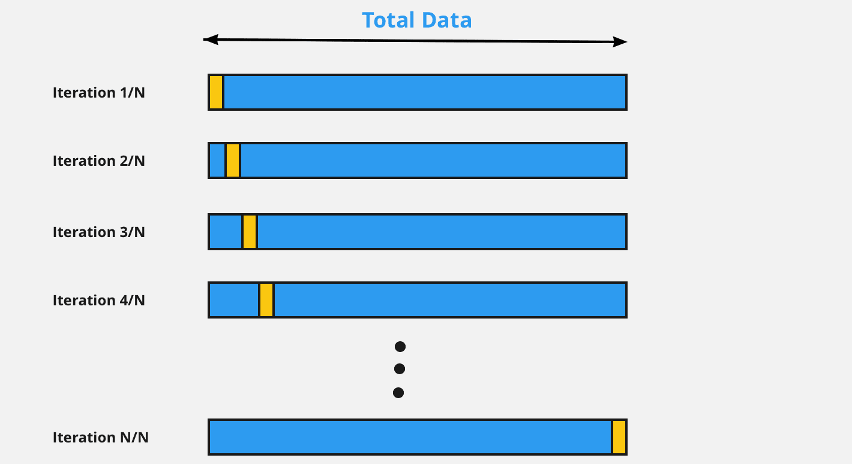
Leave-one-out cross validation
Extreme version of k-fold CV where k=N
The leave-one-out cross-validation procedure is appropriate when you have a small dataset or when an accurate estimate of model performance is more important than the computational cost of the method.
Cons
Time consuming if n is large
https://www.youtube.com/watch?v=g9c66TUylZ4

Slide 8
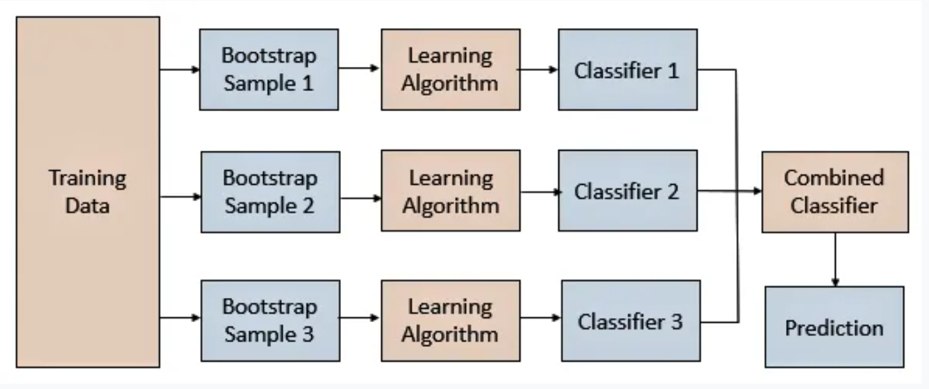
Bagging (Bootstrap aggregation )
A general-purpose procedure for reducing the variance i.e overfitting of a statistical learning method
Random forest is one of the most popular bagging algorithms.
Bagging is composed of two parts:
Bootstrapping
Aggregation

Slide 9
Bagging (Bootstrap aggregation )
Pros
Multiple weak learners can work better than a single strong learner.
It provides stability and increases the accuracy of the machine learning algorithm that is used in statistical classification and regression.
It helps in reducing variance i.e. it avoids overfitting.

Slide 10

632 Bootstrap Rule
Each bootstrap sample will contain 1−1/e≈0.632 of the sample.
We have an original sample x₁,x₂,…x_{n} with n items in it. We draw items with replacement from this original set until we have another set of size n.
From that, it follows that the probability of choosing any one item (say, x₁) on the first draw is 1/n. Therefore, the probability of not choosing that item is 1−1/n. That's just for the first draw; there are a total of n draws, all of which are independent, so the probability of never choosing this item on any of the draws is (1−1/n)^{n}.
That's the probability of an item not being chosen. Subtract it from one to find the probability of the item being chosen, which gives you 0.632.

Slide 11
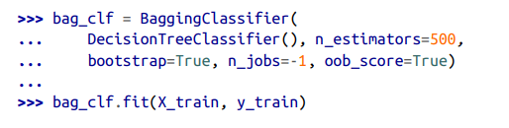

Out-of-bag Evaluation
This means that only about 63% of the training instances are sampled on average for each predictor. The remaining 37% of the training instances that are not sampled are called out-of-bag (oob) instances. Note that they are not the same 37% for all predictors
Since a predictor never sees the oob instances during training, it can be evaluated on these instances, without the need for a separate validation set

Slide 12
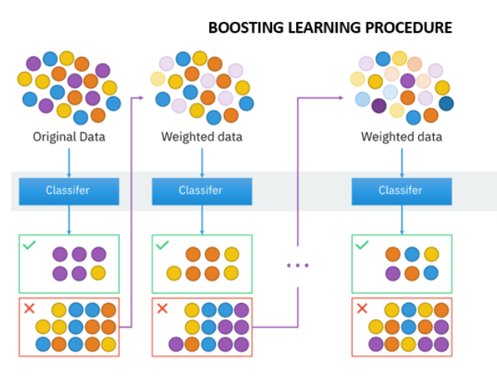
Boosting

Slide 13
Questions?

Slide 14
Recommended sources
Hands-On Machine Learning with R (Boehmke & Greenwell)
Hands-On Machine Learning with Scikit-Learn, Keras, and TensorFlow: Concepts, Tools, and Techniques to Build Intelligent Systems (Geron)
Applied Predictive Modeling (Johnson & Kuhn)
An Introduction to Statistical Learning: With Applications in R (James et al.)
Business Data Science: Combining Machine Learning and Economics to Optimize, Automate, and Accelerate Business Decisions (Taddy)
The Hundred-Page Machine Learning Book (Burkov)
https://christophm.github.io/interpretable-ml-book/shap.html
https://en.wikipedia.org/wiki/Explainable_artificial_intelligence#:~:text=Explainable%20AI%20(XAI)%20is%20artificial,arrived%20at%20a%20specific%20decision.
https://www.kaggle.com/wrosinski/shap-feature-importance-with-feature-engineering

